Slide 1
Uncertainty
Chapter 6 review slides
by Dr. Liu Yiqun

Slide 2
Outlines and Objectives:
Previously on QR
Probability and rules.
Average value.
Conditional probability.
Contingency table for medical case.
P value.
Homework

Slide 3
RR and OR
The details of RR and OR can be found in chapter 2 and chapter 5 review slides sent previously.
RR and OR are basically another (advanced and more effective) method of comparing rate of something among different groups.
Case 1: RR = 1, which means OR = 1 and there is no association.
Case 2: RR > 1, which means OR > 1 and there is a positive association. Mathematically, OR > RR > 1 in such case.
Case 3: RR < 1, OR < 1, negative association. OR < RR < 1.
For the same table, mathematically, OR seems indicating a stronger correlation, as OR is further away from 1, compared with RR.
However, there is no direct meaning of comparing RR with OR. They are just measuring the relationship in a different perspective.

Slide 4
For prospective cohort study, we can either use RR or OR to estimate that of the population. Some people prefer using RR and call that relative risk.
In some papers beyond QR, people prefer using Hazard ratio (HR) to suggest the correlation. Hazard ratio is more like a comparison of instantaneous risk among different groups. BTW, HR is a constant across the whole period.
For retrospective case control study, we usually suggest only using OR to estimate OR of the population. (as most of cases, the proportions are unknown or different. The term “proportions” are explained in the following example)

Slide 5
Probability = measure of uncertainty
P ∈ [0, 1].
0 refers to impossible and 1 refers to definitely happen. Larger p means higher chance to happen.
Probability can be interpreted using the relative frequency. P is the limit of the relative frequency in the long run.
We can also use the theoretical probability value to predict the relative frequency.

Slide 6
Equally like outcomes
Toss a coin: 0, 1. P(x = 0) = P (x =1) = ½.
P(Head) + P(tail) = 1, P(H) = P(T). Thus, P(H) = P(T) = ½.
Roll a die: 1,2,3,4,5,6.
P(x=1) = P(x=2) = P(x=6) = 1/6.
If the random circumstance has N outcomes and they are equally like,
then P(each outcome) = 1/N.

Slide 7
Simple calculation of P
Consider roll a fair die. X ∈[1,6].
P(X is even)
= 3/6 = ½.
P(X = odd) = ½.
P(X > 4) =
2/6 = 1/3.
P(X is even or X>4) = ?
= 4/6=2/3 ≠ P(X even) + P(X>4) = 5/6.

Slide 8
Simpler rules
Sum rule: If event A and B are mutually exclusive (disjoint or cannot happen at the same time),
Then P(A or B) = P(A) + P(B).
It is true for several mutually exclusive events
Complement rule: P( not A) = 1 – P(A).
Odds of A = P(A) / P( not A).
Say A and B are independent if the occur of B does not affect P(A), i.e., P(A|B) = P(A).
Multiplication rule: If A and B are independent,
Then P(A and B) = P(A)*P(B).
Notes:
P(A and B) = P(A) * P(B|A) if A and B are independent, = P(A) * P(B) since P(B|A) = P(B)

Slide 9
Using all the rules
Event H = a couple have at most 3 tries to have a boy (and then stop). P(H) = ?
P(boy) = 0.51.
P(girl) = 1- 0.51= 0.49.
Let event A = have a boy at 1st try.
Event B = have a boy exactly at 2nd try.
Event C = have a boy exactly at 3rd try.
H = A U B U C and they are mutually exclusive.

Slide 10
For a boy
P(H) = P(A) + P(B) + P(C).
P(A) = P(boy) = 0.51.
Event B = girl at 1st try and boy at 2nd try.
Assume the sex of two babies are independent.
Then P(B) = P(girl) * P(boy) =0.49 * 0.51.
Similarly, P(C) = P(girl) * P(girl) * P(boy).
Then P(H) = 0.88.

Slide 11
An easier way
P(H) = 1 – P( all girls at 3 try).
P(all girls at 3 try) = P(girl at 1st try) * P(girl at 2nd try) * P(girl at 3rd try) = P(girl)^3.
P(H) = 1 – (1-0.51)^3 = 0.88.

Slide 12
Average values
Also known as Expectation, Expected value (EV), mean.
Game with two options.
Option 1: win 1000 with no condition.
Option 2: try a 4 choices MCQ, if answering the only correct option, then win 5000. O.W., get 0.
For opt 1, EV = 1000 * 1 = 1000.
For opt 2, EV = value (A1) * P(A1) + value(A2) * P(A2) where A1 and A2 are mutually exclusive outcomes.
EV= 5000*1/4 + 0*3/4 = 1250.
Choose opt 2, since 1250 > 1000.
What if option 1: win 10 with no condition.

Slide 13
How insurance company survive ?
An insurance product: charged 500$ per person. It is estimated that 2% will claim 10000$, 5% will claim 5000$ and the rest will not claim.
For the company, EV = 500 – (10000*2% + 5000* 5% + 0 * 93%) = 50.
I.e., in the long run, if sufficient customers buy it, then on average, the company makes profit of 50 from each customer.
Personally, insurance helps us defeat the potential risk in the future while we are tolerant of the 500$ (loss) per year.

Slide 14
Conditional probability
P(event A, given the occurrence of B) can be different from P(A).
P(A | B) = P(A and B) / P(B).
This is equivalent to P(A and B) = P(B) * P(A | B).
P(B | A) = P(B and A) / P(A).
This is equivalent to P(A and B) = P(A) * P(B | A).
In general, P(A and B and C) = P(A) * P(B | A) * P(C | A, B)
Or P(A and B and C) = P(B) * P(C | B) * P(A | B,C).
P(A | B) can be different with P(B | A).
Rate (A | B) = P (A | B).
Say B = yesterday was rainy. A = today is rainning.
In the rain season, it is likely P(A | B) > P(A).
If the coming Sunday is rainy, then the concert will be canceled. Then
P(concert being canceled | Sunday is rainning) = 1.
Notes:
Suppose A and B are independent, if P(A) = P(A | B) = P(A | NOT B), then A and B have no association.
For any A and B, independent or dependent, P(A | B) < P(A) < P(A | NOT B).

Slide 15
Conditional probability
Suppose A and B are independent.
By multiplication rule, then P(A and B) = P(A)*P(B).
P(A|B) = P(A and B) / P(B) = P(A)*P(B) / P(B) = P(A).
Whether B happens or not, it doesn’t affect the probability of A happening.
P(A) is weighted average of P(A|B) and P(A | not B).
Since P(A) = P(A|B), thus P(A) = P(A|B) = P(A|not B).
So, A and B are not associated.
Independence = no association.
Independency can be tested as P(A|B) = P(A) or P(B | A) = P(B) or P(A and B) = P(A)*P(B) or no association.
A = height > 170cm. B = weight > 65kg.
A and B are not independent, as A and B are likely positively associated.

Slide 16
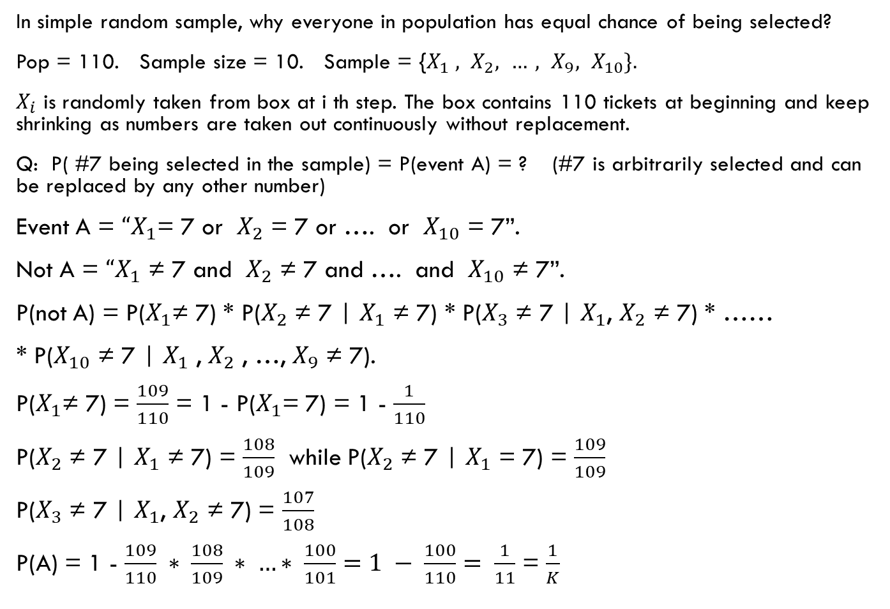
In simple random sample, why everyone in population has equal chance of being selected?
Pop = 110. Sample size = 10. Sample = {$X_{1} , X_{2}, …, X_{9}, X_{10}\}.$
$X_{i}$ is randomly taken from box at i th step. The box contains 110 tickets at beginning and keep shrinking as numbers are taken out continuously without replacement.
Q: P( #7 being selected in the sample) = P(event A) = ? (#7 is arbitrarily selected and can be replaced by any other number)
Event A = ${“X}_{1}$= 7 or $X_{2}$ = 7 or …. or $X_{10}$ = 7”.
Not A = ${“X}_{1}$ ≠ 7 and $X_{2}$ ≠ 7 and …. and $X_{10}$ ≠ 7”.
P(not A) = P($X_{1}$≠ 7) * P($X_{2}$ ≠ 7 | $X_{1}$ ≠ 7) * P($X_{3}$ ≠ 7 | $X_{1}$, $X_{2}$ ≠ 7) * ……
* P($X_{10}$ ≠ 7 | $X_{1}$ , $X_{2}$ , …, $X_{9}$ ≠ 7).
P($X_{1}$≠ 7) = $\frac{109}{110}$ = 1 - P($X_{1}$= 7) = 1 - $\frac{1}{110}$
P($X_{2}$ ≠ 7 | $X_{1}$ ≠ 7) = $\frac{108}{109}$ while P($X_{2}$ ≠ 7 | $X_{1}$ = 7) = $\frac{109}{109}$
P($X_{3}$ ≠ 7 | $X_{1}$, $X_{2}$ ≠ 7) = $\frac{107}{108}$
P(A) = 1 - $\frac{109}{110} ∗ \frac{108}{109} ∗ …∗ \frac{100}{101}=1 − \frac{100}{110}= \frac{1}{11}$ = $\frac{1}{K}$

Slide 17
Innocent or Guilty ?
D is the event of double cot death while E the event that Sally is innocent.
Suppose P(D | E) can be calculated and is very small.
Is that true that Sally is guilty?
We need P(E | D).
If P(E|D) is small, then we convince that Sally is guilty. O.W., we either claim that Sally is innocent or need more evidence.
However, P(D | E) ≠ P (E | D).
Flipped rate can be different in general.

Slide 18
Contingency table for medical case
Pop = 100000. P(disease) = 0.1%.
Sensitivity = P(positive | disease) = 95%.
Specificity = P(negative | no disease) = 90%.
 | Positive | Test Neg | Sum
Disease | 95 | 5 | 100
No D | 9990 | 89910 | 99900
Sum | 10085 | 89915 | 100000

Slide 19
Reliable test ?
P(healthy | negative) = 89910/89915 = 99.99%.
If negative, happy.
P(disease | positive) = 95/10085 = 0.94%.
Among 100 people who are test positive, only 1 develops disease later.
The test is not effective for this case.
P( d | + ) can be used to compare different tests, which are testing the same symptom.

Slide 20
Hypothesis testing
A method of statistical inference.
Conclude a claim by rejecting the counter-claim (negation of the claim) statistically.
The counter-claim is referred as null hypothesis.
Null is usually something that seems not compatible with the observation. Mathematically, it can be stated as an equation, in most cases.
Alternative hypothesis is usually the expected claim, or something that seems to be more compatible with the observation.
Suppose toss a coin for 5 times and the observed result is HHHTH. (4H1T)
If the coin is fair, then P(H)=P(T) = ½.
It is more likely that 3H2T or 2H3T.
The coin seems to be unfair.

Slide 21
Null hypothesis and P value
Specify the threshold first, say 5%. (research sometimes prefers 1% or even less). In final exam, without notification, it is 5%.
We start with a null hypothesis that P(H) = ½, which is better than saying that coin is fair. (We wish to reject it.) Alternative hypothesis is P(H) > ½. (one tailed)
P value is the probability of events that are equivalent to or more extreme than the observed, given the null hypothesis.
p = P(4H1T) + P(5H).
P(4H1T) = 5 * (1/2)^4 * (1/2) = 5 * (1/2)^5.
P(5H) = 1*(1/2)^5. (in this case, only one event counts as more extreme, according to alternative hypothesis.
p = 0.18.

Slide 22
Inference
p = 0.18 > 0.05.
we do not reject the null hypothesis at the 5% significance level.
In other words, the evidence is not statistically significant, or say, insufficient evidence to reject the null.
But we didn’t prove or accept the null hypothesis.
If observation is HHHHH, P = 0.03 < 0.05.
we reject the null hypothesis in favor of the alternative hypothesis.
Or say, we accept the alternative hypothesis,
Or say, we conclude “the coin is biased against tail” at a certain level of statistical significance. We try to avoid call it is a proof as there is a (small) chance that we are making a wrong claim.

Slide 23
Threshold (beyond module)
Significance level: 1% or 5% or 10%.
It should be decided before calculating P value.
It indicates the probability of making (Type I) error is small and being bounded by the threshold, given the null is true.
If P value = 3% < 5%, then we claim P(H) > ½ at the 5% significance level.
However, in practical, it is still possible that P(H) = ½. Our claim is wrong but actually null is correct. This is a (Type I) error. (or false positive)
Good news is that the chance of making such mistake, given the null is true, is being bounded by 5%. Our claim is most likely correct (roughly 95% cases).
Thus, by choosing 1%, it is harder to reject. Whenever we reject the null, the claim is more reliable. That is why research usually use 1% and often uses “P value << 1%” to indicate the significance of the claim (say the observed difference is not likely to be caused by random error or purely by chance).
Note that statistically significant and practically significant (clinically significant) are different. To really “prove” something needs much more effort in real life, while the statistical test can still give us some insight or trigger other studies.

Slide 24
Two tailed test (beyond module and only for those who learned two tailed test before)
Observe HHHTH.
Null: P(H) = ½. Alternative: P(H) ≠ ½.
P value = P(4H1T) + P(4T1H) + P(5H) + P(5T).
4H1T, 4T1H are equivalent to HHHTH under Alternative Hypothesis.
5H0T，5T0H are both more extreme than HHHTH under Alternative.
P value = 2 * (P(4H1T) + P(5H)) = 0.36.
If the distribution under null is symmetry, then (2 tailed) P value = 2* (1 tailed) P value. If using same threshold, two tailed test is harder to reject the null. Hence, the conclusion in two tailed test are, if rejecting the null, relatively stronger than that in one tailed test.
For one tailed test, if not rejecting the null, the conclusion is relatively weak, as we don’t know much about whether P(H) = ½ or P(H) is actually significantly less than ½.

Slide 25
Homework
A pregnant female is provided the following list of tests which aim at detecting fetal anomalies including Down’s Syndrome. (Trisomy 21 or T21)
She is strongly encouraged to take one of these by her doctor.
Suppose you are her advisor, pls make your choice after going through the following link and applying our QR method to analyze.
The different tests can detect different list of fetal anomalies and at different prices. For convenience of discussion, let us just focus in accuracy in Down’s Syndrome. (DS)
The base rate for DS is 1/750 (in Singapore).
Detection rate = sensitivity. (pls think about it)
False positive rate = 1 – specificity. (think about it)
Hint: compare P( True DS | test positive).
Compare P ( No DS | test negative).
Pls collect detection rate and false positive rate from different websites.

Slide 26
Option 1: OSCAR (including NT test)
https://www.thomsonmedical.com/birth-at-thomson/pre-admission/prenatal-tests/
The price is roughly 300 - 400 S$.
Option 2: Panorama Test
http://www.panoramatest.com/panorama-test/clinical-information
Price is roughly 1300+ S$.
Option 3: Harmony Test
http://www.ariosadx.com/nejm-harmony-next-study
Price is roughly 1000+ S$.
Option 4: Igene Test
http://www.igeneprenataltest.com/clinical-data/
Price is roughly 800+ S$.
Trust me that you will face this choice question in future.

Slide 27
Thank you!

